Slide 1
Project- Flight price prediction
By-
ASHISH KUMAR SAMAL

Slide 2

BUSINESS PROBLEM FRAMING
Data source about different flights and there prices in websites like yatra.com, skyscanner.com, official websites of airlines, etc).
Data Analysis of flight price data using given features and their values.
Gives insights about customer need and satisfaction as well as reviews regarding different E-Retail.
These columns areairline name, date of journey, source, destination, route, departure time, arrival time, duration, total stops and the target variable price.
The research furthermore investigated the factors that influences the price of a flight.
It helps us to find the best time to buy so that the consumer can save the most by taking the least risk.

Slide 3
Hardware and Software Tools
Laptop
Numpy
Pandas
Imblearn
Seaborn
Matplotlib
Sklearn
Phone
Jupyter
Youtube
Github

Slide 4
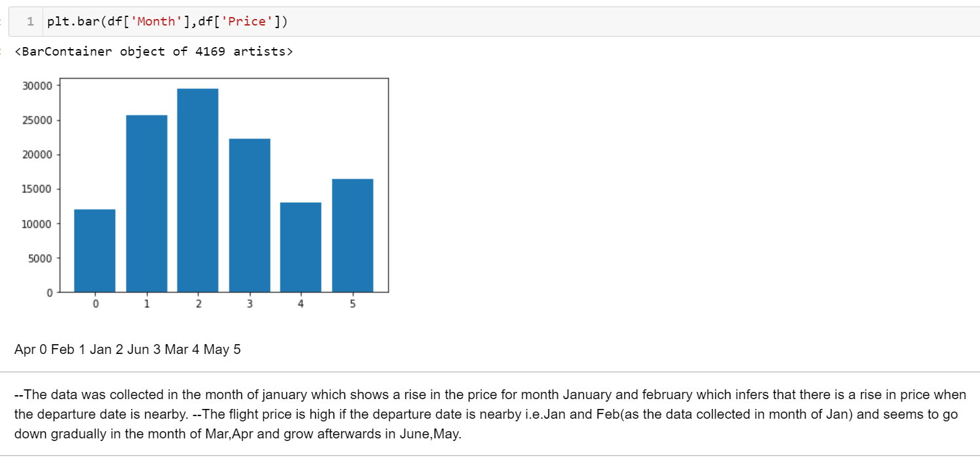
Data Analysis

Slide 5
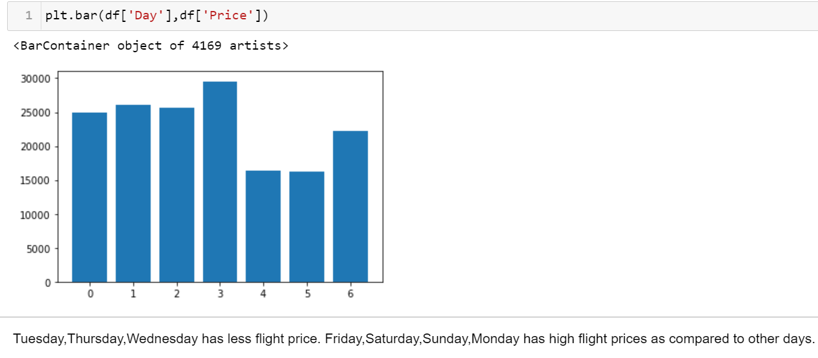
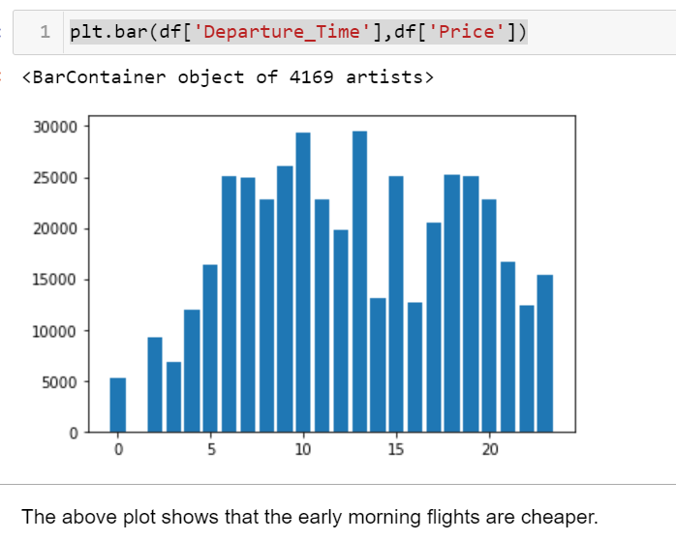
Data Analysis

Slide 6
INFEREnces made
Air Asia and Indigo flights seem to be generally cheaper as compared to Air India and Vistara. Tuesday,Thursday,Wednesday has less flight price. Friday,Saturday,Sunday,Monday has high flight prices as compared to other days.
The data was collected in the month of January therefore it shows a rise in the price for month January and february which infers that there is a rise in price when the departure date is nearby.
The flight price is high if the departure date is nearby i.e.Jan and Feb(as the data collected in month of Jan) and seems to go down gradually in the month of Mar,Apr and grow afterwards in June,May.
Early morning flights are cheaper than flights at other time.
Hence, the best time to book a flight is before one or two month and look for days between Tuesday to thursday so that the consumer can save the most by taking the least risk.

Slide 7
@ During promotion and sales period,amazon users face long time to log in and displaying graphics/photo followed by
paytm and snapdeal.
@ During promotion and sales period myntra declares price the most late,followed by paytm.
@ Paytm takes longer time to load page,followed by snapdeal and amazon.
@ During promotion snapdeal has most limited mode of payment followed by amazon.
@ Paytm has long delivery time.
@ Amazon has developed their website/application design over time and still efficient.
@ Amazon has got best customer loyalty as it has the most percieved trustworthiness but
it needs to upgrade the platforms to take less time to load or log in during promotion or sales period.
@ Myntra,snapdeal and paytm should develop their performance of platform and percieve more trustworthiness by
securing the privacy of customer data.

Slide 8
Customer needs
we can see customers want the following services---
@ users want a wide variety of listed product in several category.
@ userfriendly interface in which contents are easy to read and
understood,want product comparison alomg with complete andrelevant info on listed products to be stated clearly.
@ Ease of navigation in website,along with the loading and processing speed.
@ Convinient payment methods.
@ Empathy towards customer and guarantee the privacy of the customer leads to more trust worthiness which leads to
user satisfaction.
@ The need of assistance along with responsivness on several channels like web,email,phone,etc.
@ several customers feel the sense of adventure,gratification on shopping from their favorite e-tailer and
enhances the social status too.

Slide 9
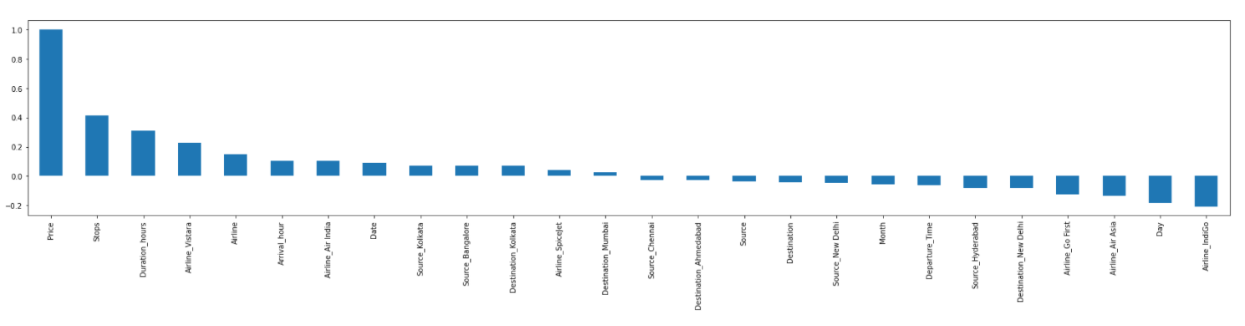
Conclusion
Following is the plot of feature importance with respect to price.

Slide 10
THANKYOU
Github Link-https://github.com/Ashsam2310/Practice_Projects/

